Slide 1
TUMMI
By Veer Shah, Kshrugal Jain, Owen Isenhart, Joel Kota, Francisco Rojas, Chaiyun Suhr, and Liya Rajeev
CS3354
Group 6

Slide 2
Table of Contents
Objective
Cost Estimation
Project Timeline
Project & Staff Estimation
Software Process Model
Requirements
Use Case Diagram
Sequence Diagram
Class Diagram
Architectural Design

Slide 3
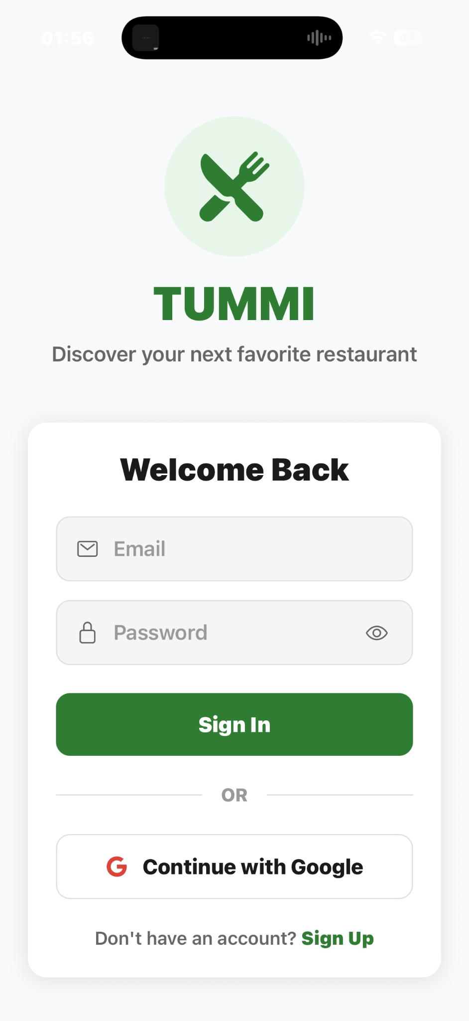
Objective
Build a campus-focused food recommendation app that helps students quickly discover restaurants that match their dietary needs, cravings, and cultural preferences.
Reduce the time and frustration spent searching through generic maps and menus.
We propose a tailored campus-focused food recommendation app that delivers accurate, preference-based results in seconds.

Slide 4
Software Process Model
Selected Model: Incremental Process Model
Incremental Process Model
Combines linear and parallel processing flows to produce increments of different stages of the software.
Allows for immediate user feedback after each release.
Why We Chose It:
We can focus on the core functionality features (dietary filters) first before adding complex social features.
Lower cost when accommodating changes compared to the Waterfall mode.
Allows us to build versions with real data from user feedback instead of making assumptions.
Implementation Plan:
Increment 1: User Accounts, Restaurant List, Basic Dietary Filters.
Increment 2: Onboarding Questionnaire, Recommendation Engine.
Increment 3: Trending Spots, Favorites, Social Features

Slide 5
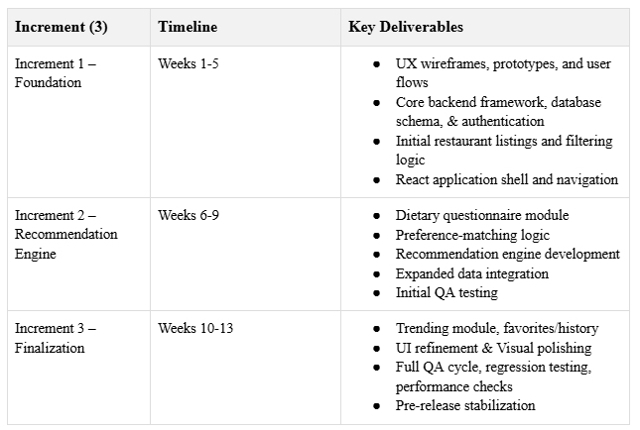
Project Duration and Staffing Estimation
Estimated Project Duration:
~ 13 weeks

Slide 6
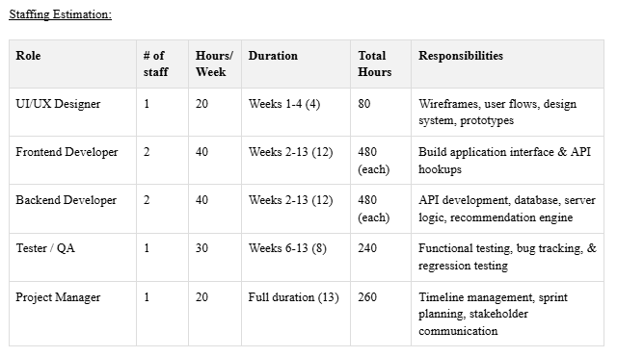
Project Duration and Staffing Estimation

Slide 7
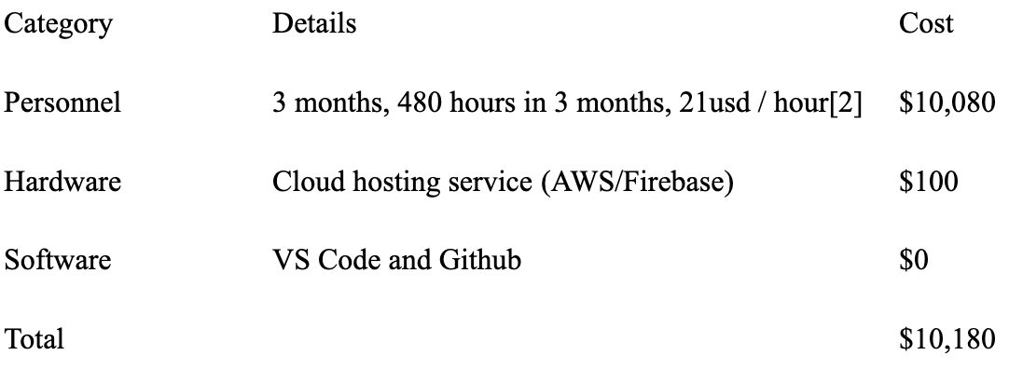
Cost Estimation
We will be using the Application composition model to estimate the costs since that model is well versed for prototypes or early stage projects. We will be counting the number of object points (number of screens) to find the complexity.
We were able to identify 12 object points which consisted of 5 screens (Login, welcome page, home screen, search, detail page), 2 reports (history page and favorites). Using the lecture slides, the complexity weights this would total to about 12 object points.
To estimate development effort realistically, we assume a professional software team operating in a standard 40 hour work week. Based on typical productivity, we use an industry average of 5 object points per developer per month.
This gives us a total effort of 2.5 months to finish the project since we have 12 object points and we will finish at a rate of 5 object points a month.

Slide 8
Project Timeline
Estimated timeline:
Start date: August 21, 2025
End date: November 23, 2025
Reason: The timeline should be within the academic semester of Fall 2025. We will be following an incremental model since we will have 3 parts.
Part 1: August - September (Forming the team, introductions, brainstorming and writing our proposal)
Part 2: September - October (Our first deliverable, consisting of the requirements of our application and the various diagrams)
Part 3: October - November (The second and final deliverable which consists of our implementation, testing, and finalization of testing for our application)

Slide 9
Functional Requirements
User account and preferences:
The user can create/log in to an account using their email or through gmail
Onboarding questionnaire:
The app initially asks questions about preferred cuisines, restaurants as well as dietary restrictions to learn the user’s preferences.
The information given by the user is then used to give a personalized recommendation.
Restaurant Recommendations:
The app uses the user’s current location as well as the recommendation to give a list of nearby restaurants that match.
The recommendation is displayed by the name, cuisine type, distance as well as the rating of the restaurant.
Search and filter:
There is a search tab/bar that can be used to display the restaurants by the name or cuisine
Filter option can be used to filter by either rating, cuisines or distance.
Favorites and History:
There is a favorites tab and button the user can click on when viewing restaurants to add it to their favorites list.
The app keeps track of the recently viewed locations and searches for the user to come back to.

Slide 10
Non-Functional Requirements
Performance: The app should be made to respond fairly quickly (for searches and recommendations) while not taking up a lot of resources.
Security: The login info of the user should only be saved if the user ticks on the box that specifies so. None of the data of the user should be exposed.
Scalability: The app (mainly the backend) should be able to handle a lot of incoming requests by multiple accounts from the same campus.
Availability: The app should be up and available all times if it is being hosted on a cloud service.

Slide 11
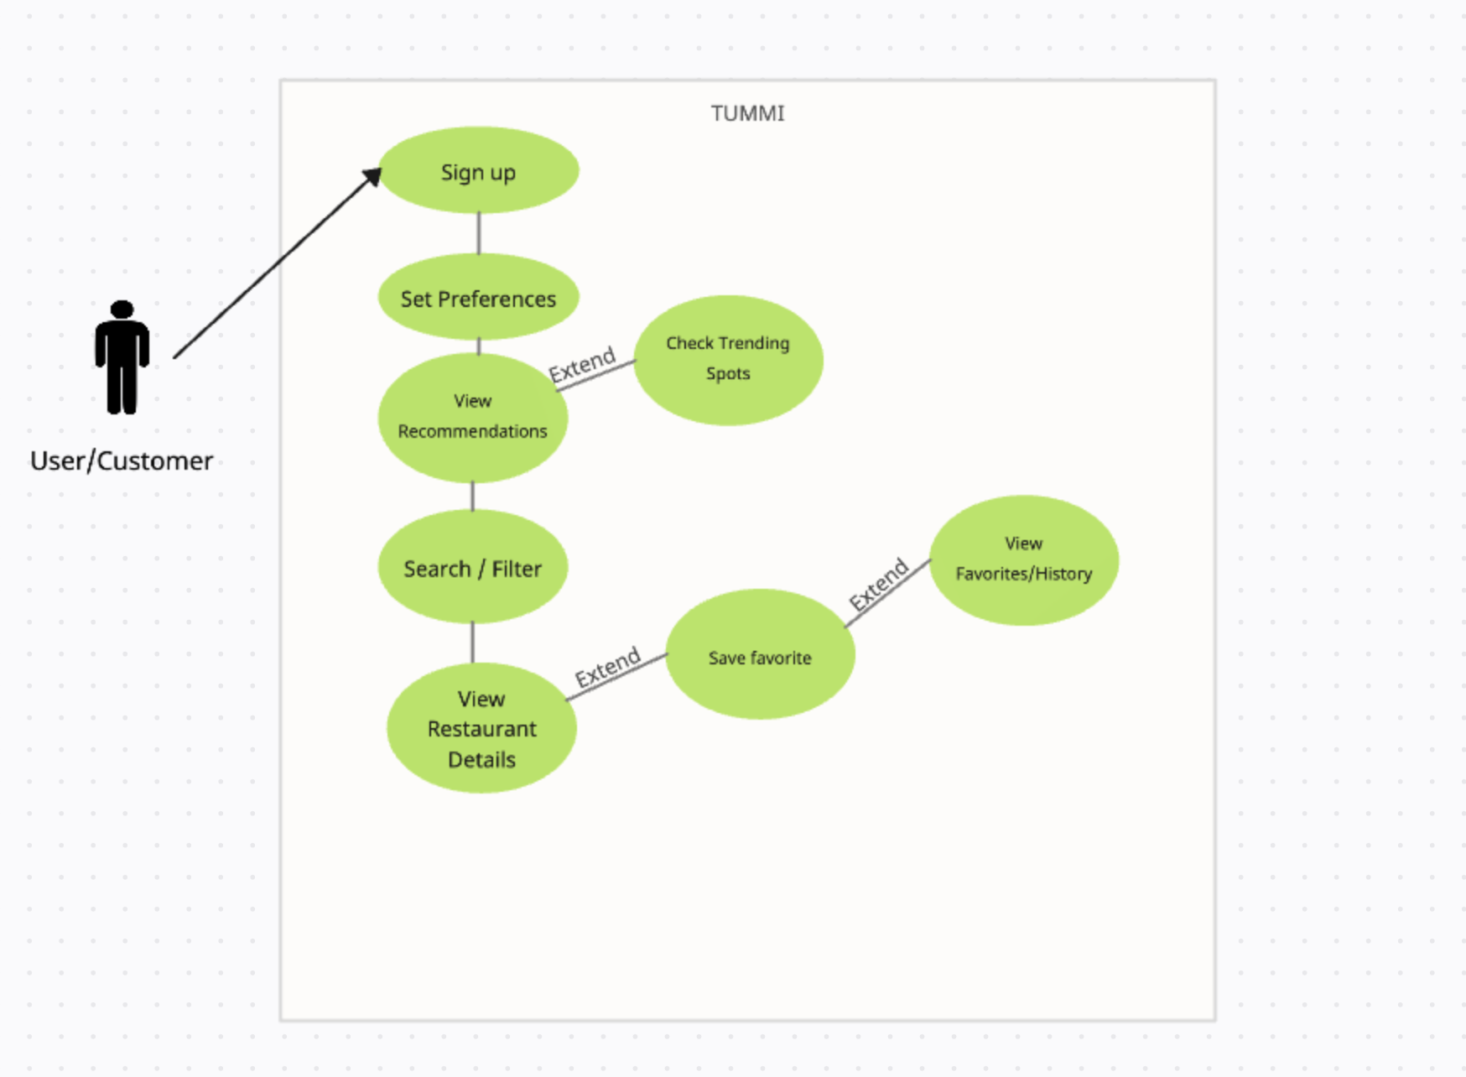
Use Case Diagram
This diagram shows the user flow.
The user should start with the sign up then set their preferences by answering a few questions.
They will then see their personalized recommendation based on the questions answered.

Slide 12
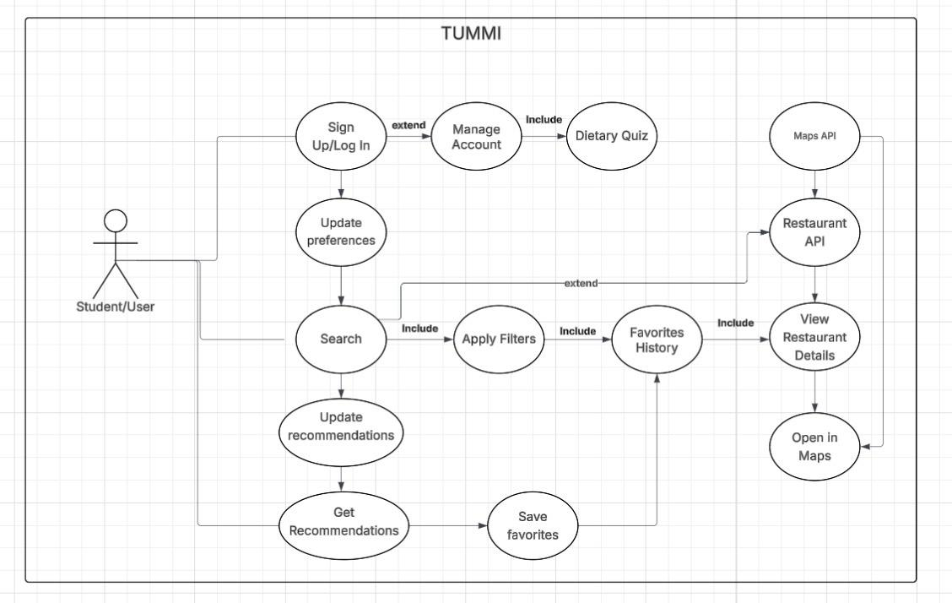
Use Case Stories
Sign up / log in to save preferences
Take dietary quiz for personalized results
Update cravings or dietary needs anytime
Search and apply filters (price, craving, distance, rating)
Get smart restaurant recommendations
View restaurant details and open in Maps
Save favorites and check past visits

Slide 13
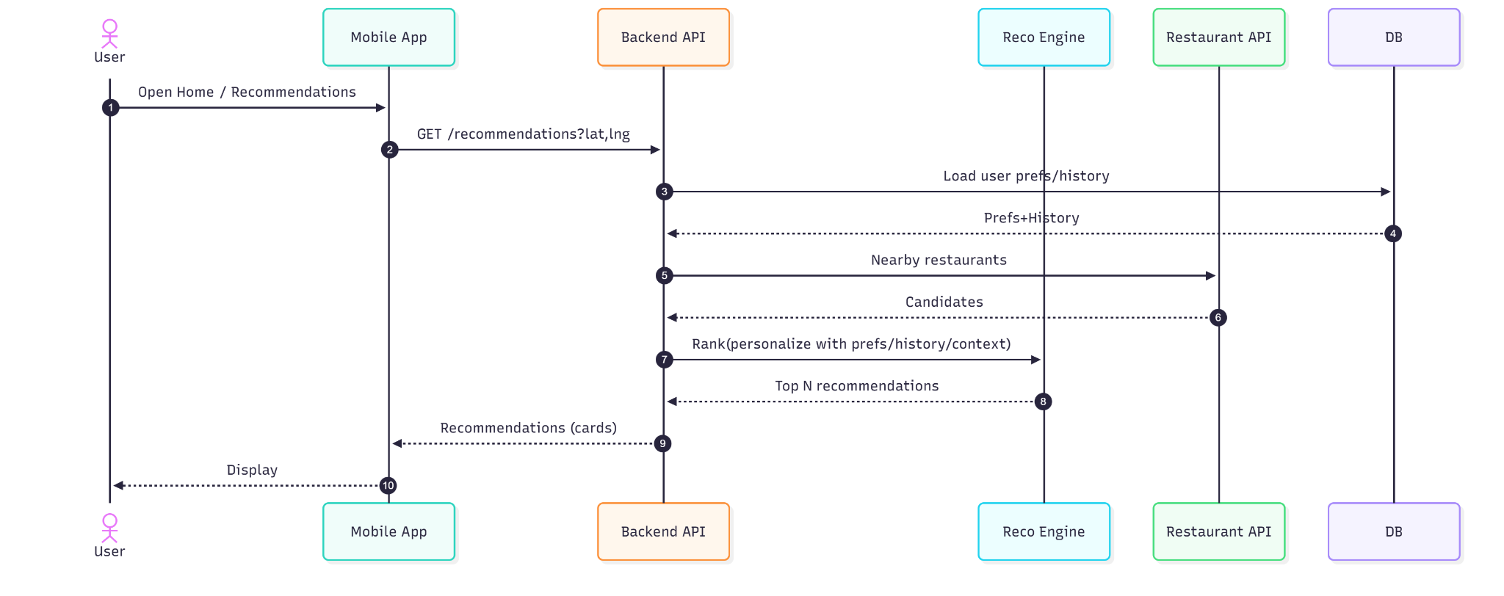
Sequence Diagram (Getting Recommendations)

Slide 14
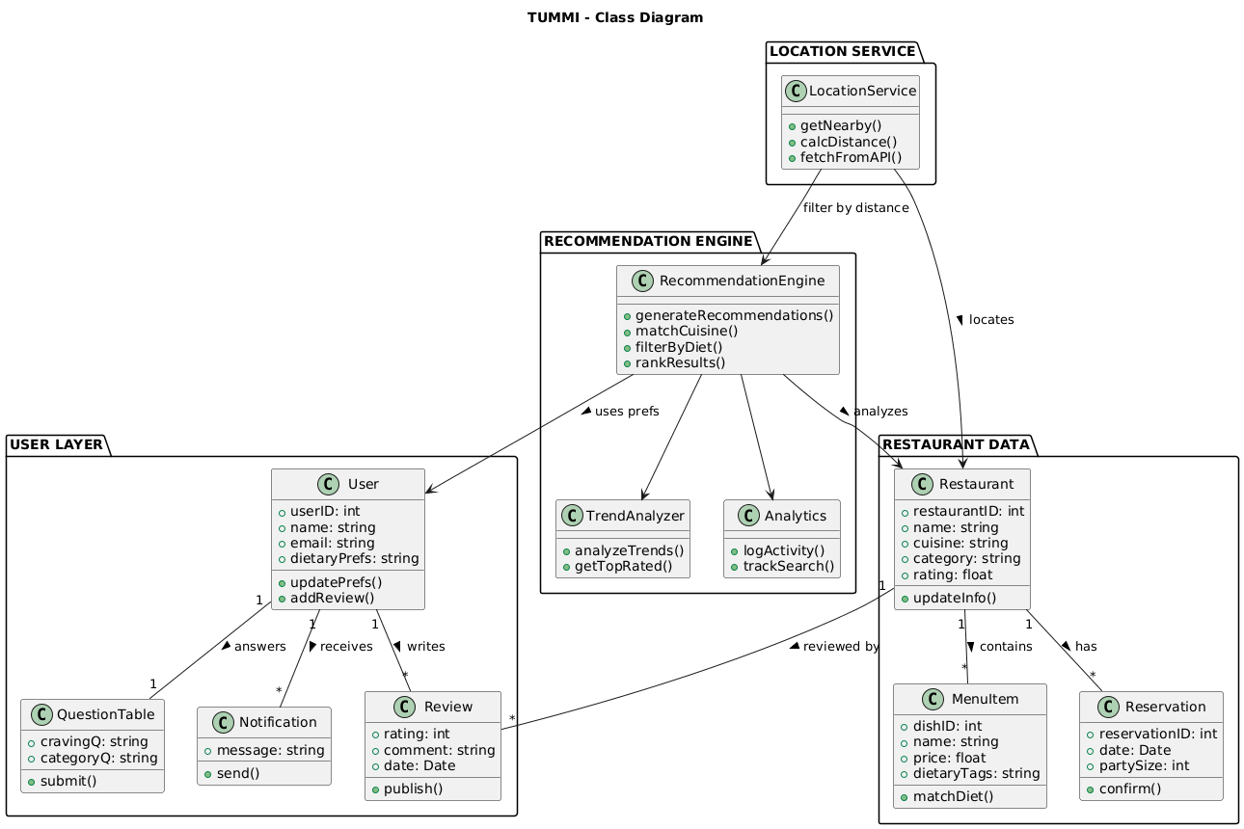
Class Diagram
Notes:
Chaiyun: Design a Class Diagram to organize data for accounts, restaurants, and different food.
Organizes the system into 4 clear components: user layer, recommendation engine, restaurant data, and location service.
The user layer includes:
Answering preference questions, receiving notifications, writing reviews
The recommendation engine generates personalized food suggestions by analyzing user preferences, trends, and most recent activity
Location service supports finding nearby restaurants and calculating distances for recommendations
Relationships between classes illustrate how user preferences and reviews influence recommendations -> while feedback and analytics improve future results

Slide 15
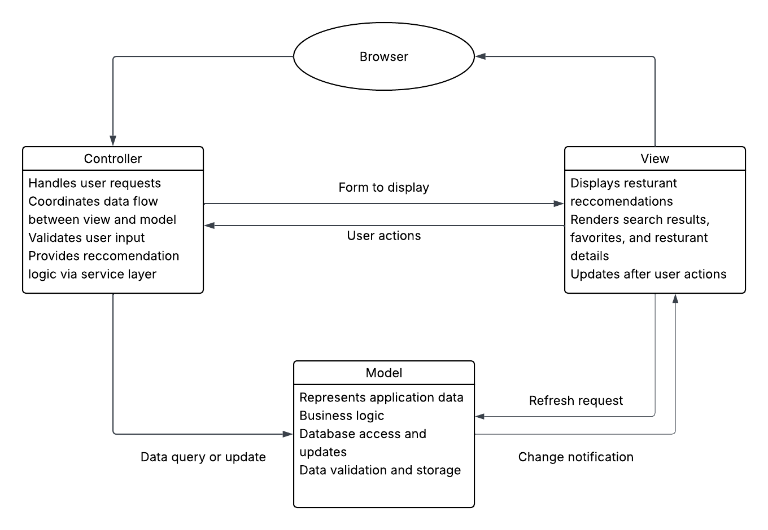
Architectural Design
TUMMI follows the model-view-controller (MVC) architectural pattern.
The controller collects inputs, performs validation, and handles traffic.
The model manages our application’s business logic, database, and updates the view if data changes.
The view is responsible for visually rendering the application and sending user events to the controller.

Slide 16
THANK YOU

